Slide 1
Machine Learning 101

Slide 2
Notes:
The McGill initiative on Computational Medicine was formed in 2017 and aims to deliver inter-disciplinary research programs and empower the use of data in health research and health care delivery
Located at the Genome Center
They have a newsletter were you can subscribe to
more info on the web site

Slide 4
Workshop agenda
Intro to Machine Learning (ML)
ML models
Applications and challenge
Code implementation
Coding session – group activity
Q&A

Slide 5

Terminologies
Artificial Intelligence (AI)
Broader science (domain) of incorporating human intelligence to machines
Machine Learning (ML)
Subset of AI, provides computer ability to learn and improve from experience
Many algorithms: Artificial Neural Networks (ANNs), Support Vector Machines (SVM), Decision Trees (DTs) , …
Deep Learning (DL)
Evolution of ML
Advanced models of ANN
Extracting and finding features
Data Science
Umbrella term for the above terms
Widely used in industry
Includes data mining
https://blogs.nvidia.com/blog/2016/07/29/whats-difference-artificial-intelligence-machine-learning-deep-learning-ai/

Slide 6
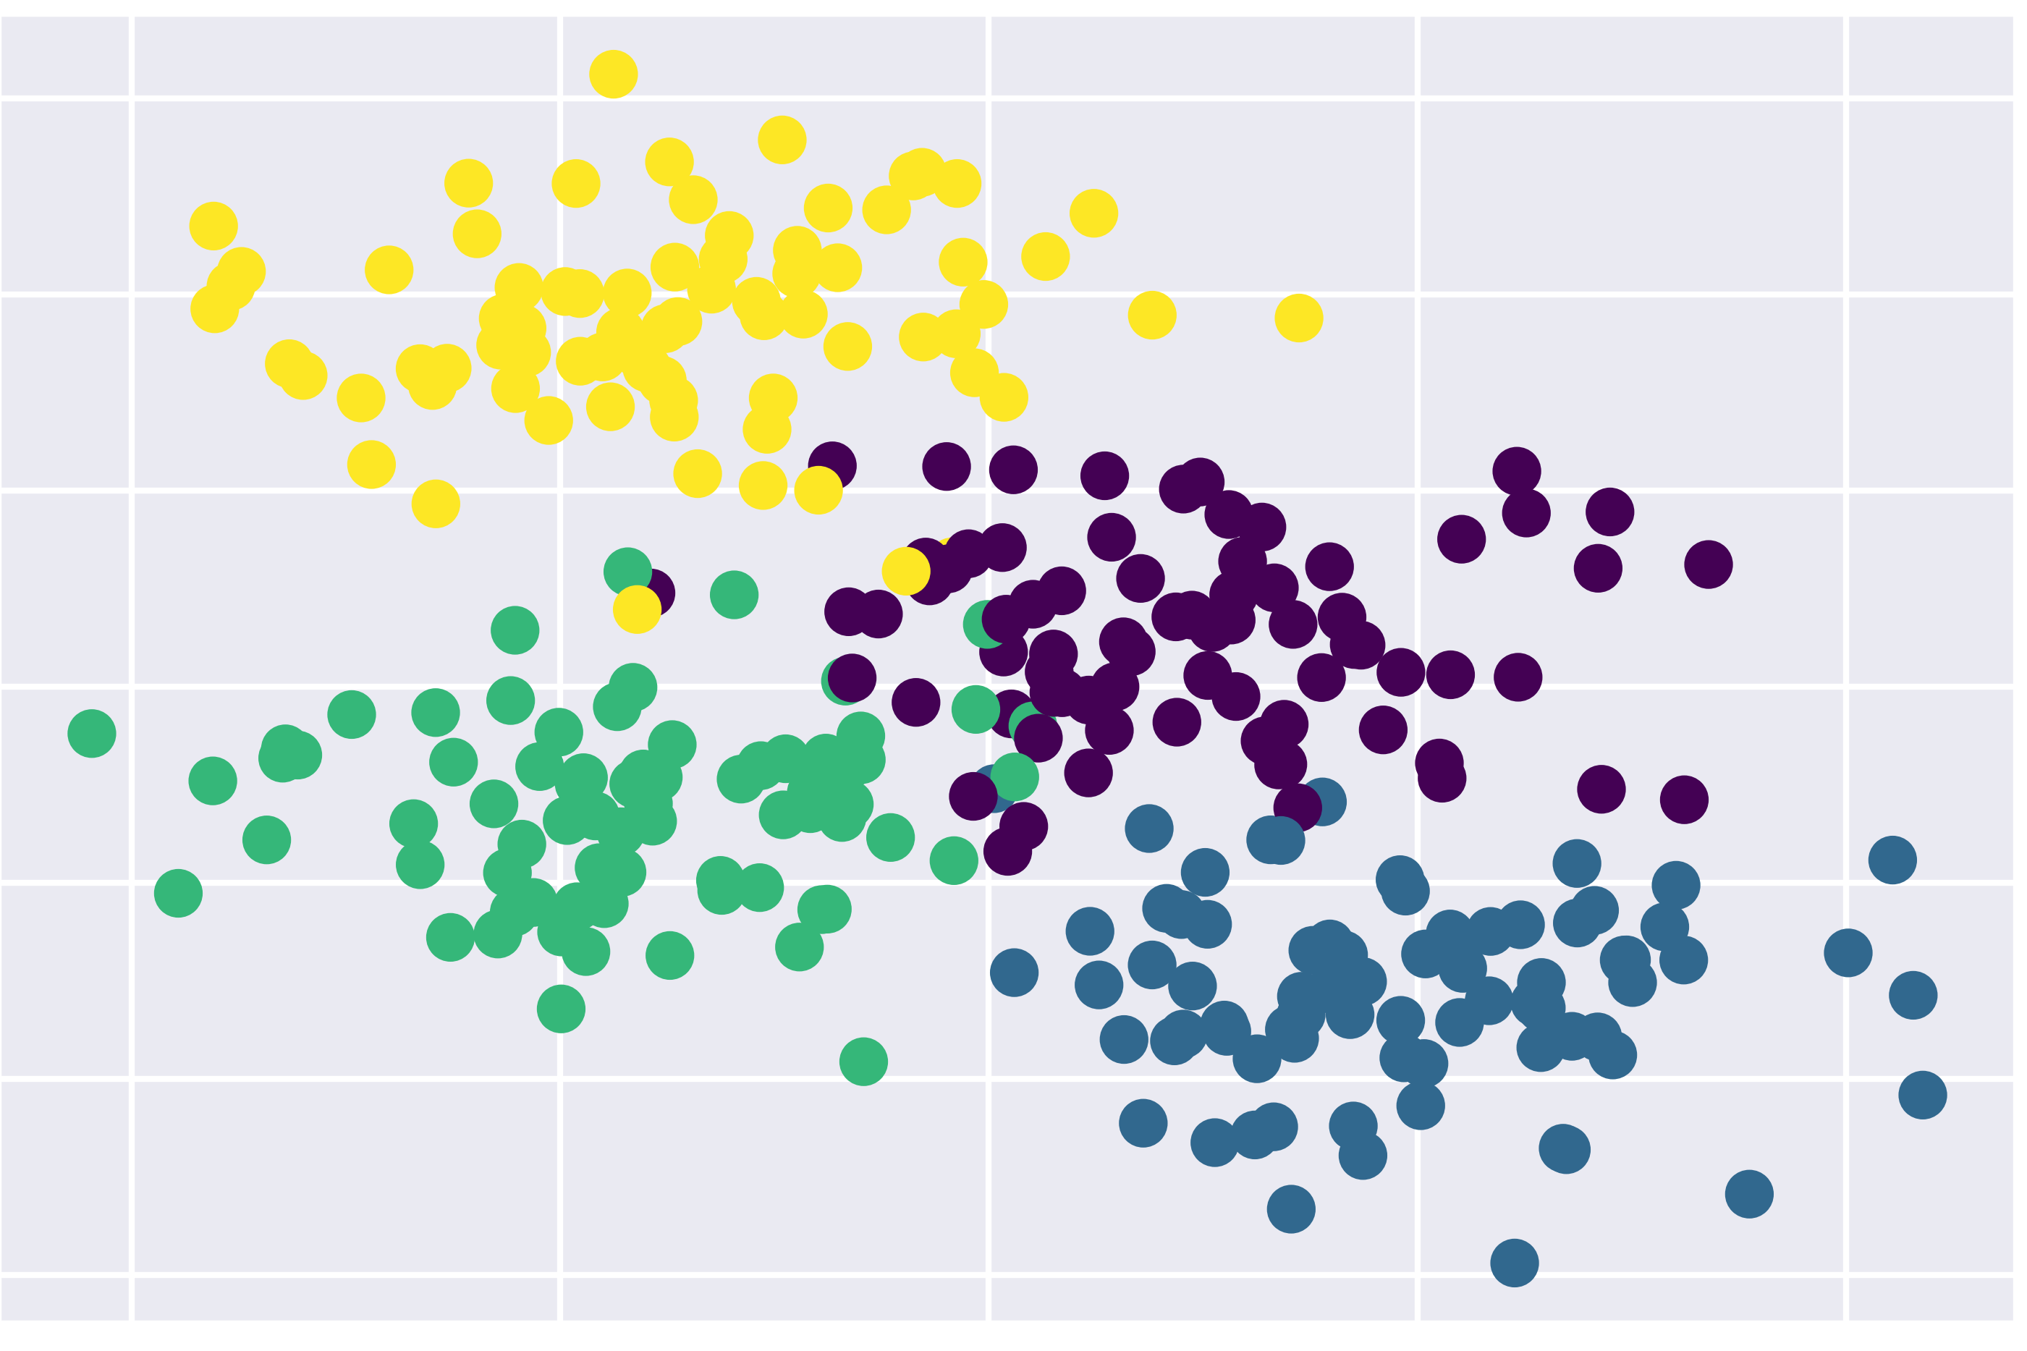
ML broad tasks
Classification
E.g., images classification, cancer detection, email spams
Regression
E.g., weather forecasting,
Clustering
Partitioning data into regions

Slide 7
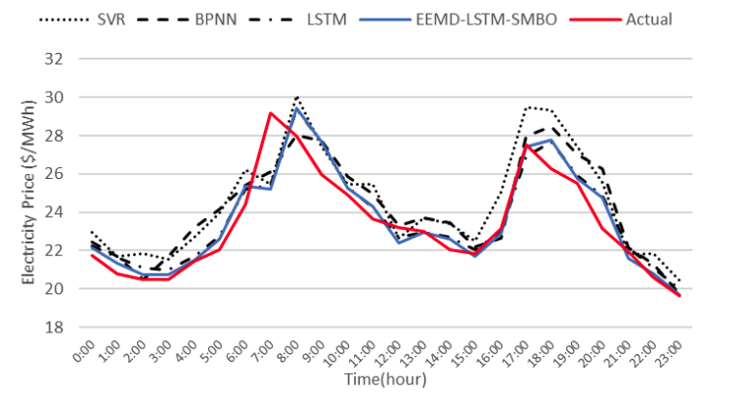
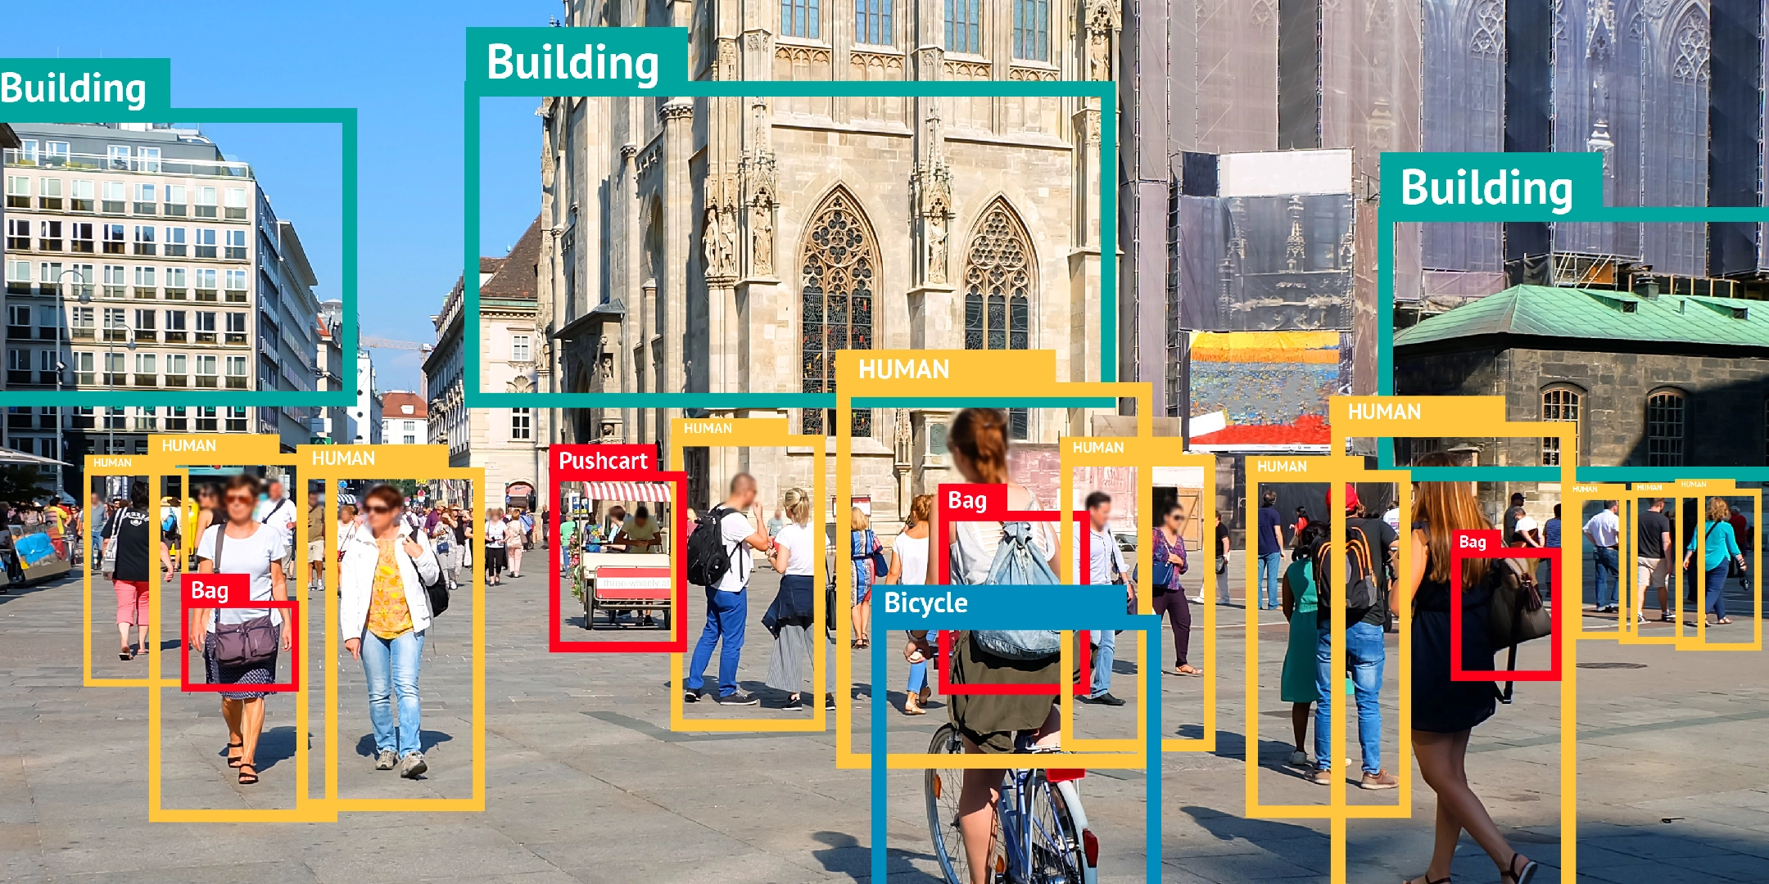
ML models
Supervised learning
We have labeled data
Classification, regression, ranking, …
Zhou et al. “An Optimized heterogeneous structure LSTM Network for Price Forecasting”, 2019.
https://bitmovin.com/object-detection/

Slide 8
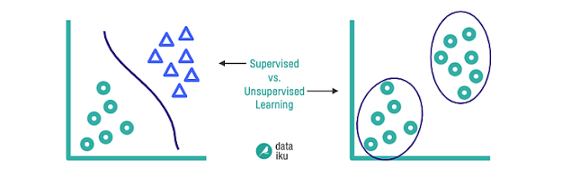
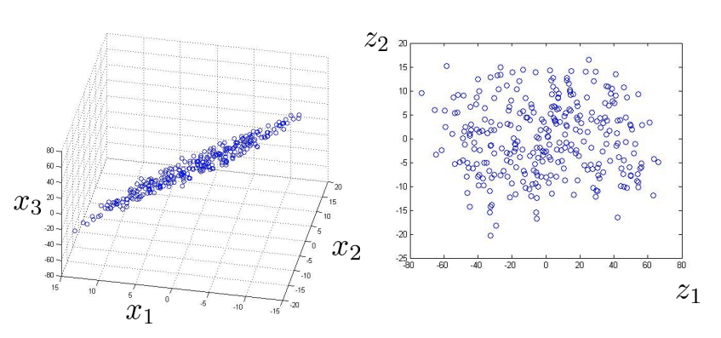
ML models
Unsupervised learning
We don’t provide labels
Clustering, dimensionality reduction
https://blog.dataiku.com/clustering-how-it-works-in-plain-english

Slide 9
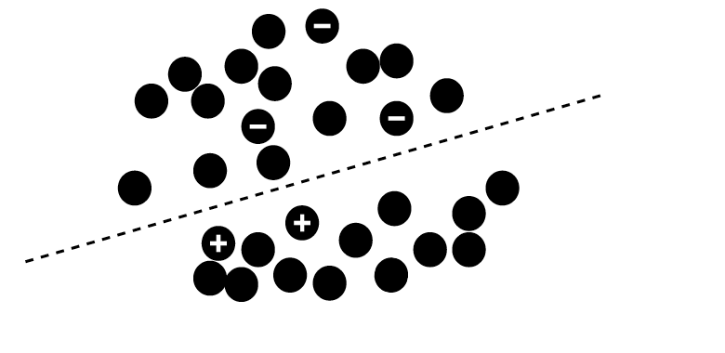
ML models
Semi-supervised learning
Only a subset of data is labeled

Slide 10
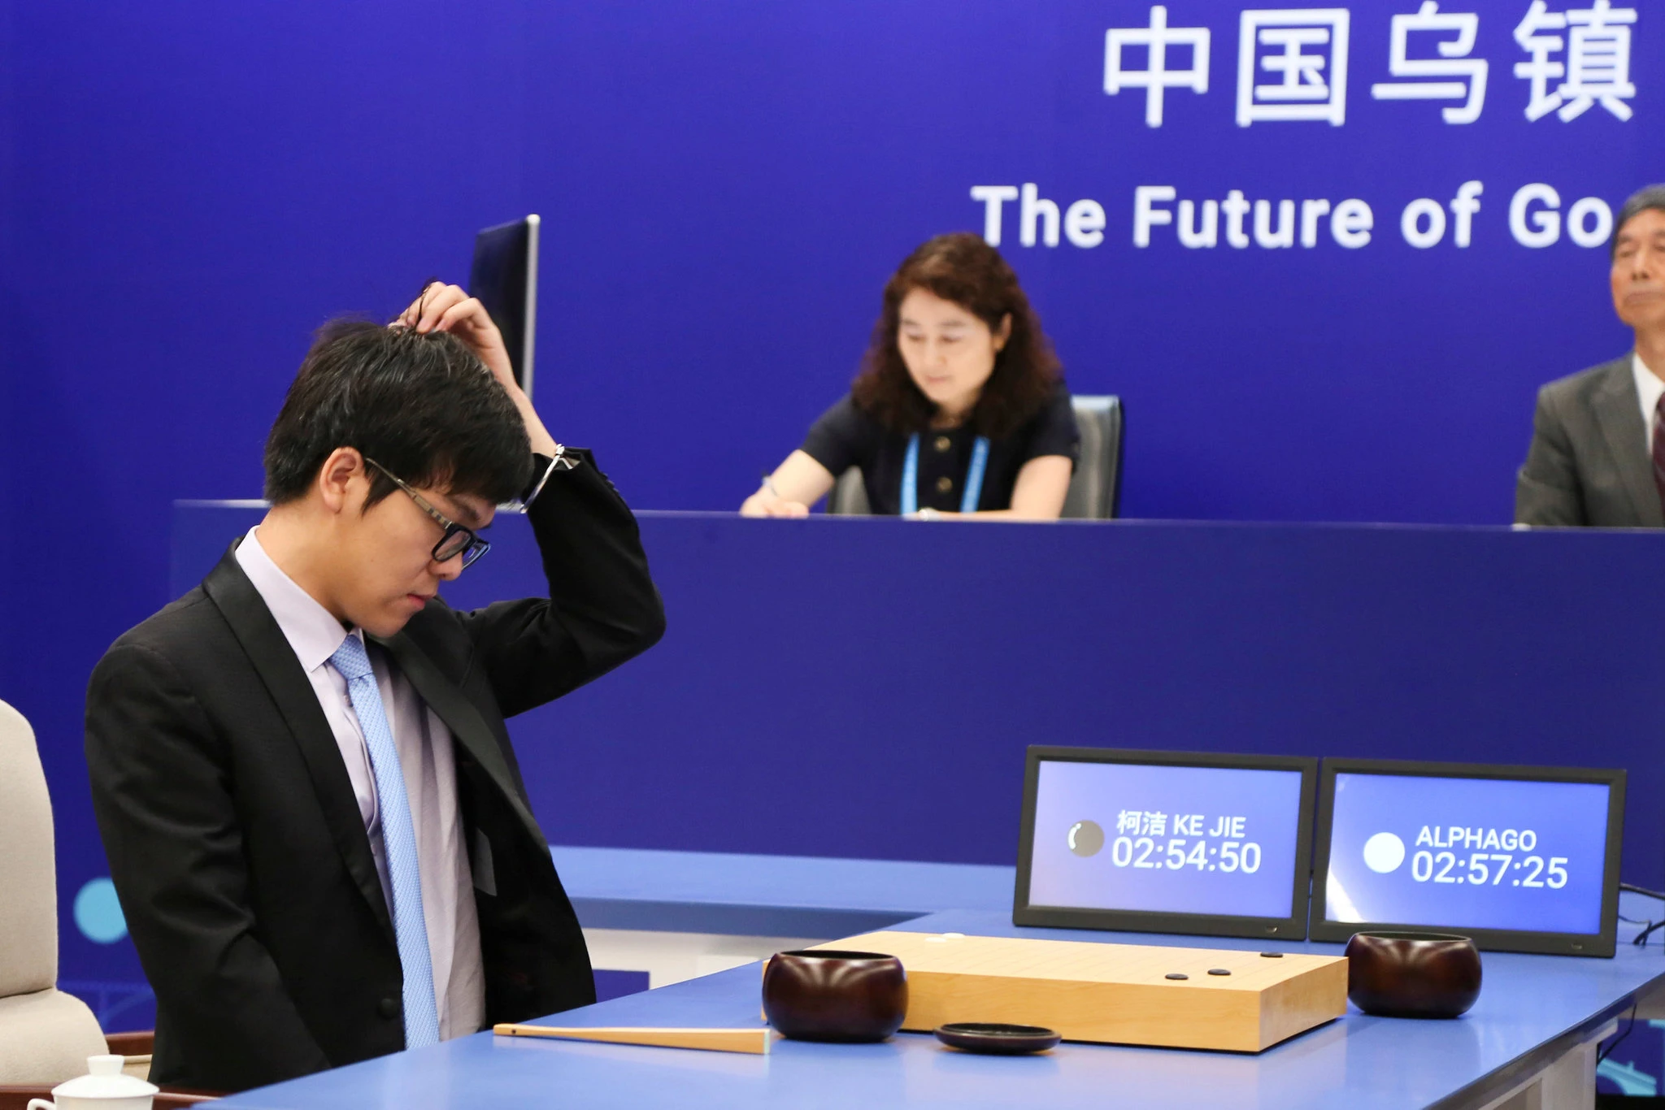
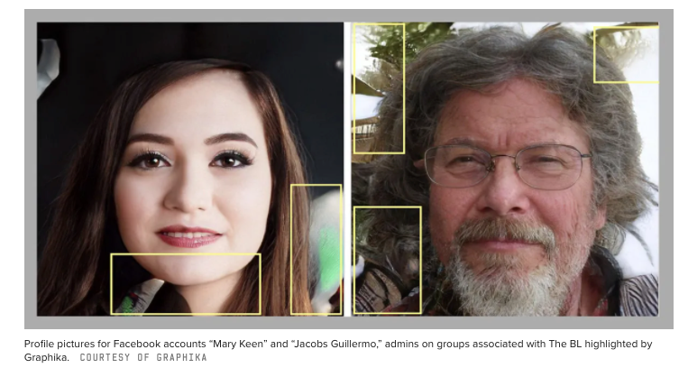
ML models
Reinforcement learning
Reward signal
Facebook Removes Accounts With AI-Generated Profile Photos
Ke Jie, the world’s top Go player, reacting during his match on Tuesday against AlphaGo, artificial intelligence software developed by a Google affiliate. Credit...China Stringer Network, via Reuters. May 23, 2017

Slide 11
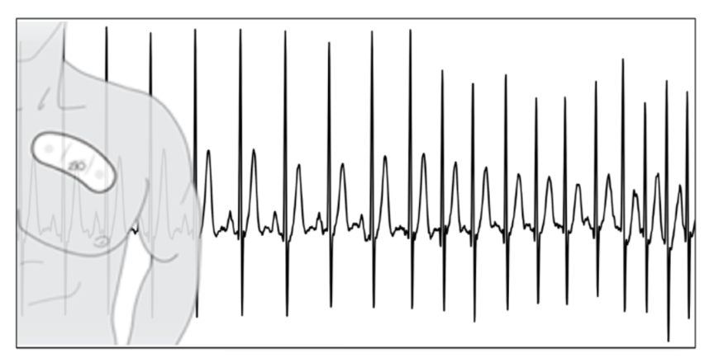
ML applications
Theoretical vs Applied ML
Importance of domain knowledge
Data preprocessing
Results interpretation
ECG data: Rajpurkar et al., 2017

Slide 12
Main ML concepts
Learning definition
How to measure learning?
Error between prediction and actual target
Adjust model parameters to decrease error
Repeat until convergence
Loss function

Slide 13
Main ML concepts
Objective definition
Data preparation
Model selection
1
Training
Evaluation
Parameters tuning
2
3
Inference
Final model

Slide 14
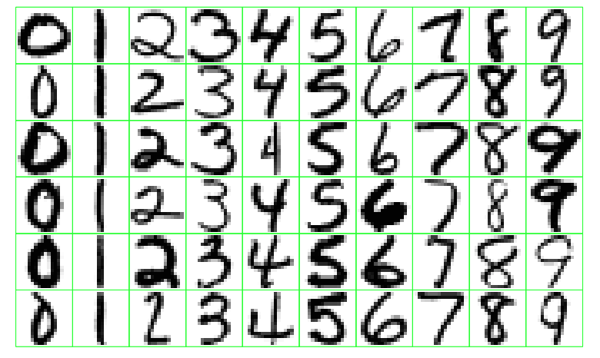
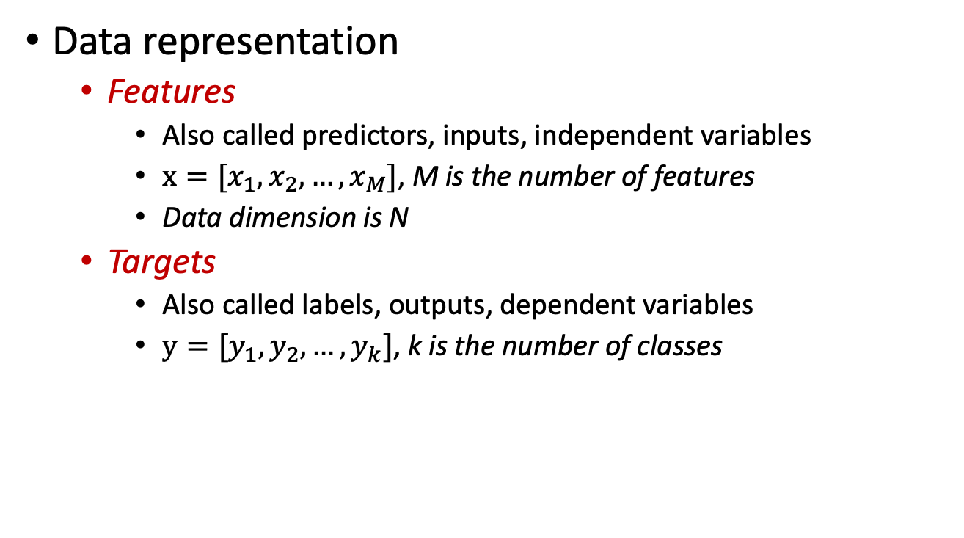
Main ML concepts
Data representation
Features
Also called predictors, inputs, independent variables
$x=[x_{1}, x_{2}, …, x_{M}]$, M is the number of features
Data dimension is N
Targets
Also called labels, outputs, dependent variables
$y=[y_{1}, y_{2}, …, y_{k}]$, k is the number of classes
Classes
N Samples

Slide 15
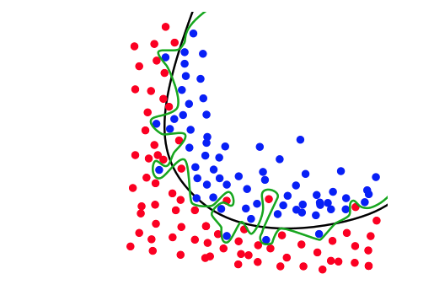
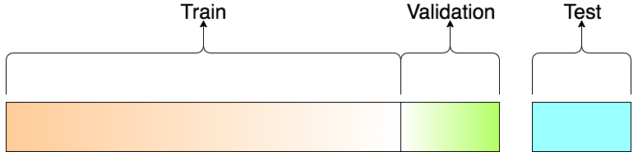
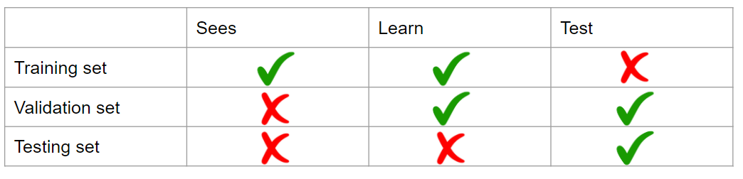
Main ML concepts
Data split into training and testing sets
Avoids overfitting
Important for generalization in the real world
Cross validation
https://elitedatascience.com/overfitting-in-machine-learning

Slide 16
Decision Trees (DTs)
Main idea: Divide space into regions using a tree structure
Classification tasks: class label
Regression tasks: real scalar
Build the DT based on the value of a single variable

Slide 17
DTs motivation
Handling of categorical variables.
Handling of missing values and unknown values.
Detection of non-linear relationships.
Visualization and interpretation in decision trees.

Slide 18
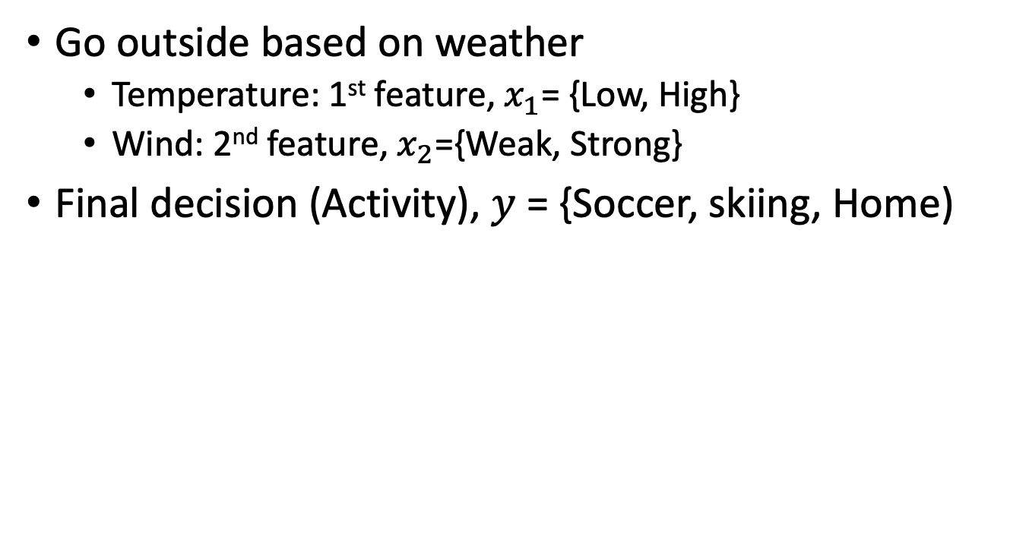
DTs main idea
Go outside based on weather
Temperature: 1st feature, $x_{1}$= {Low, High}
Wind: 2nd feature, $x_{2}$={Weak, Strong}
Final decision (Activity), $y$ = {Soccer, skiing, Home)
Low Temperature?
Strong wind?
Play soccer
Stay home
Strong wind?
Go skiing
Stay home
No
Yes

Slide 19
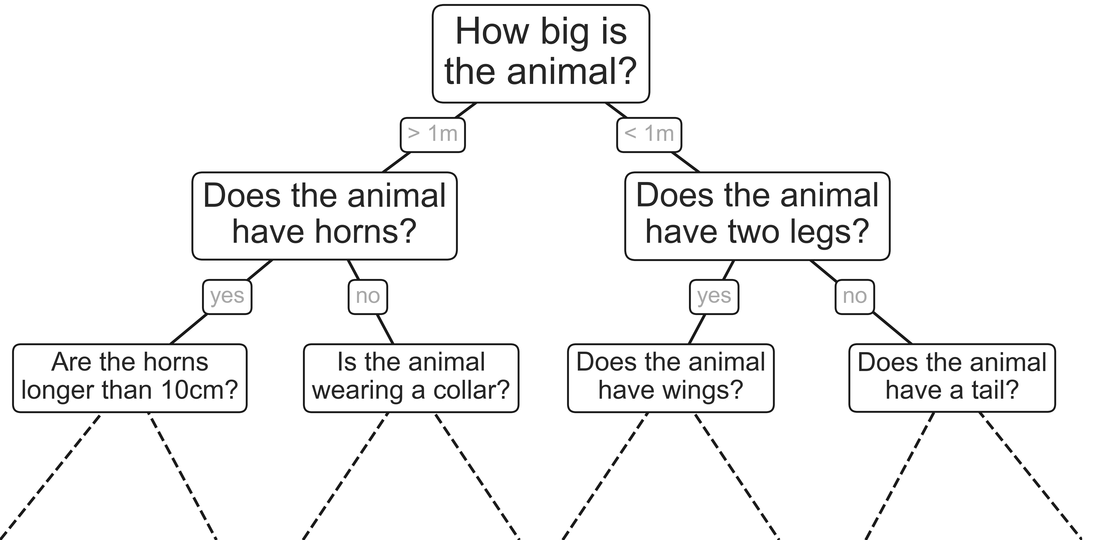
DTs motivation
Intuitive way to classify objects
Series of questions
Example: classify animals based on criteria

Slide 20
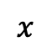
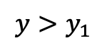
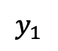
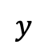
DTs example
$$y>y_{1}$$
$$y$$
$$y_{1}$$
$$x$$

Slide 21
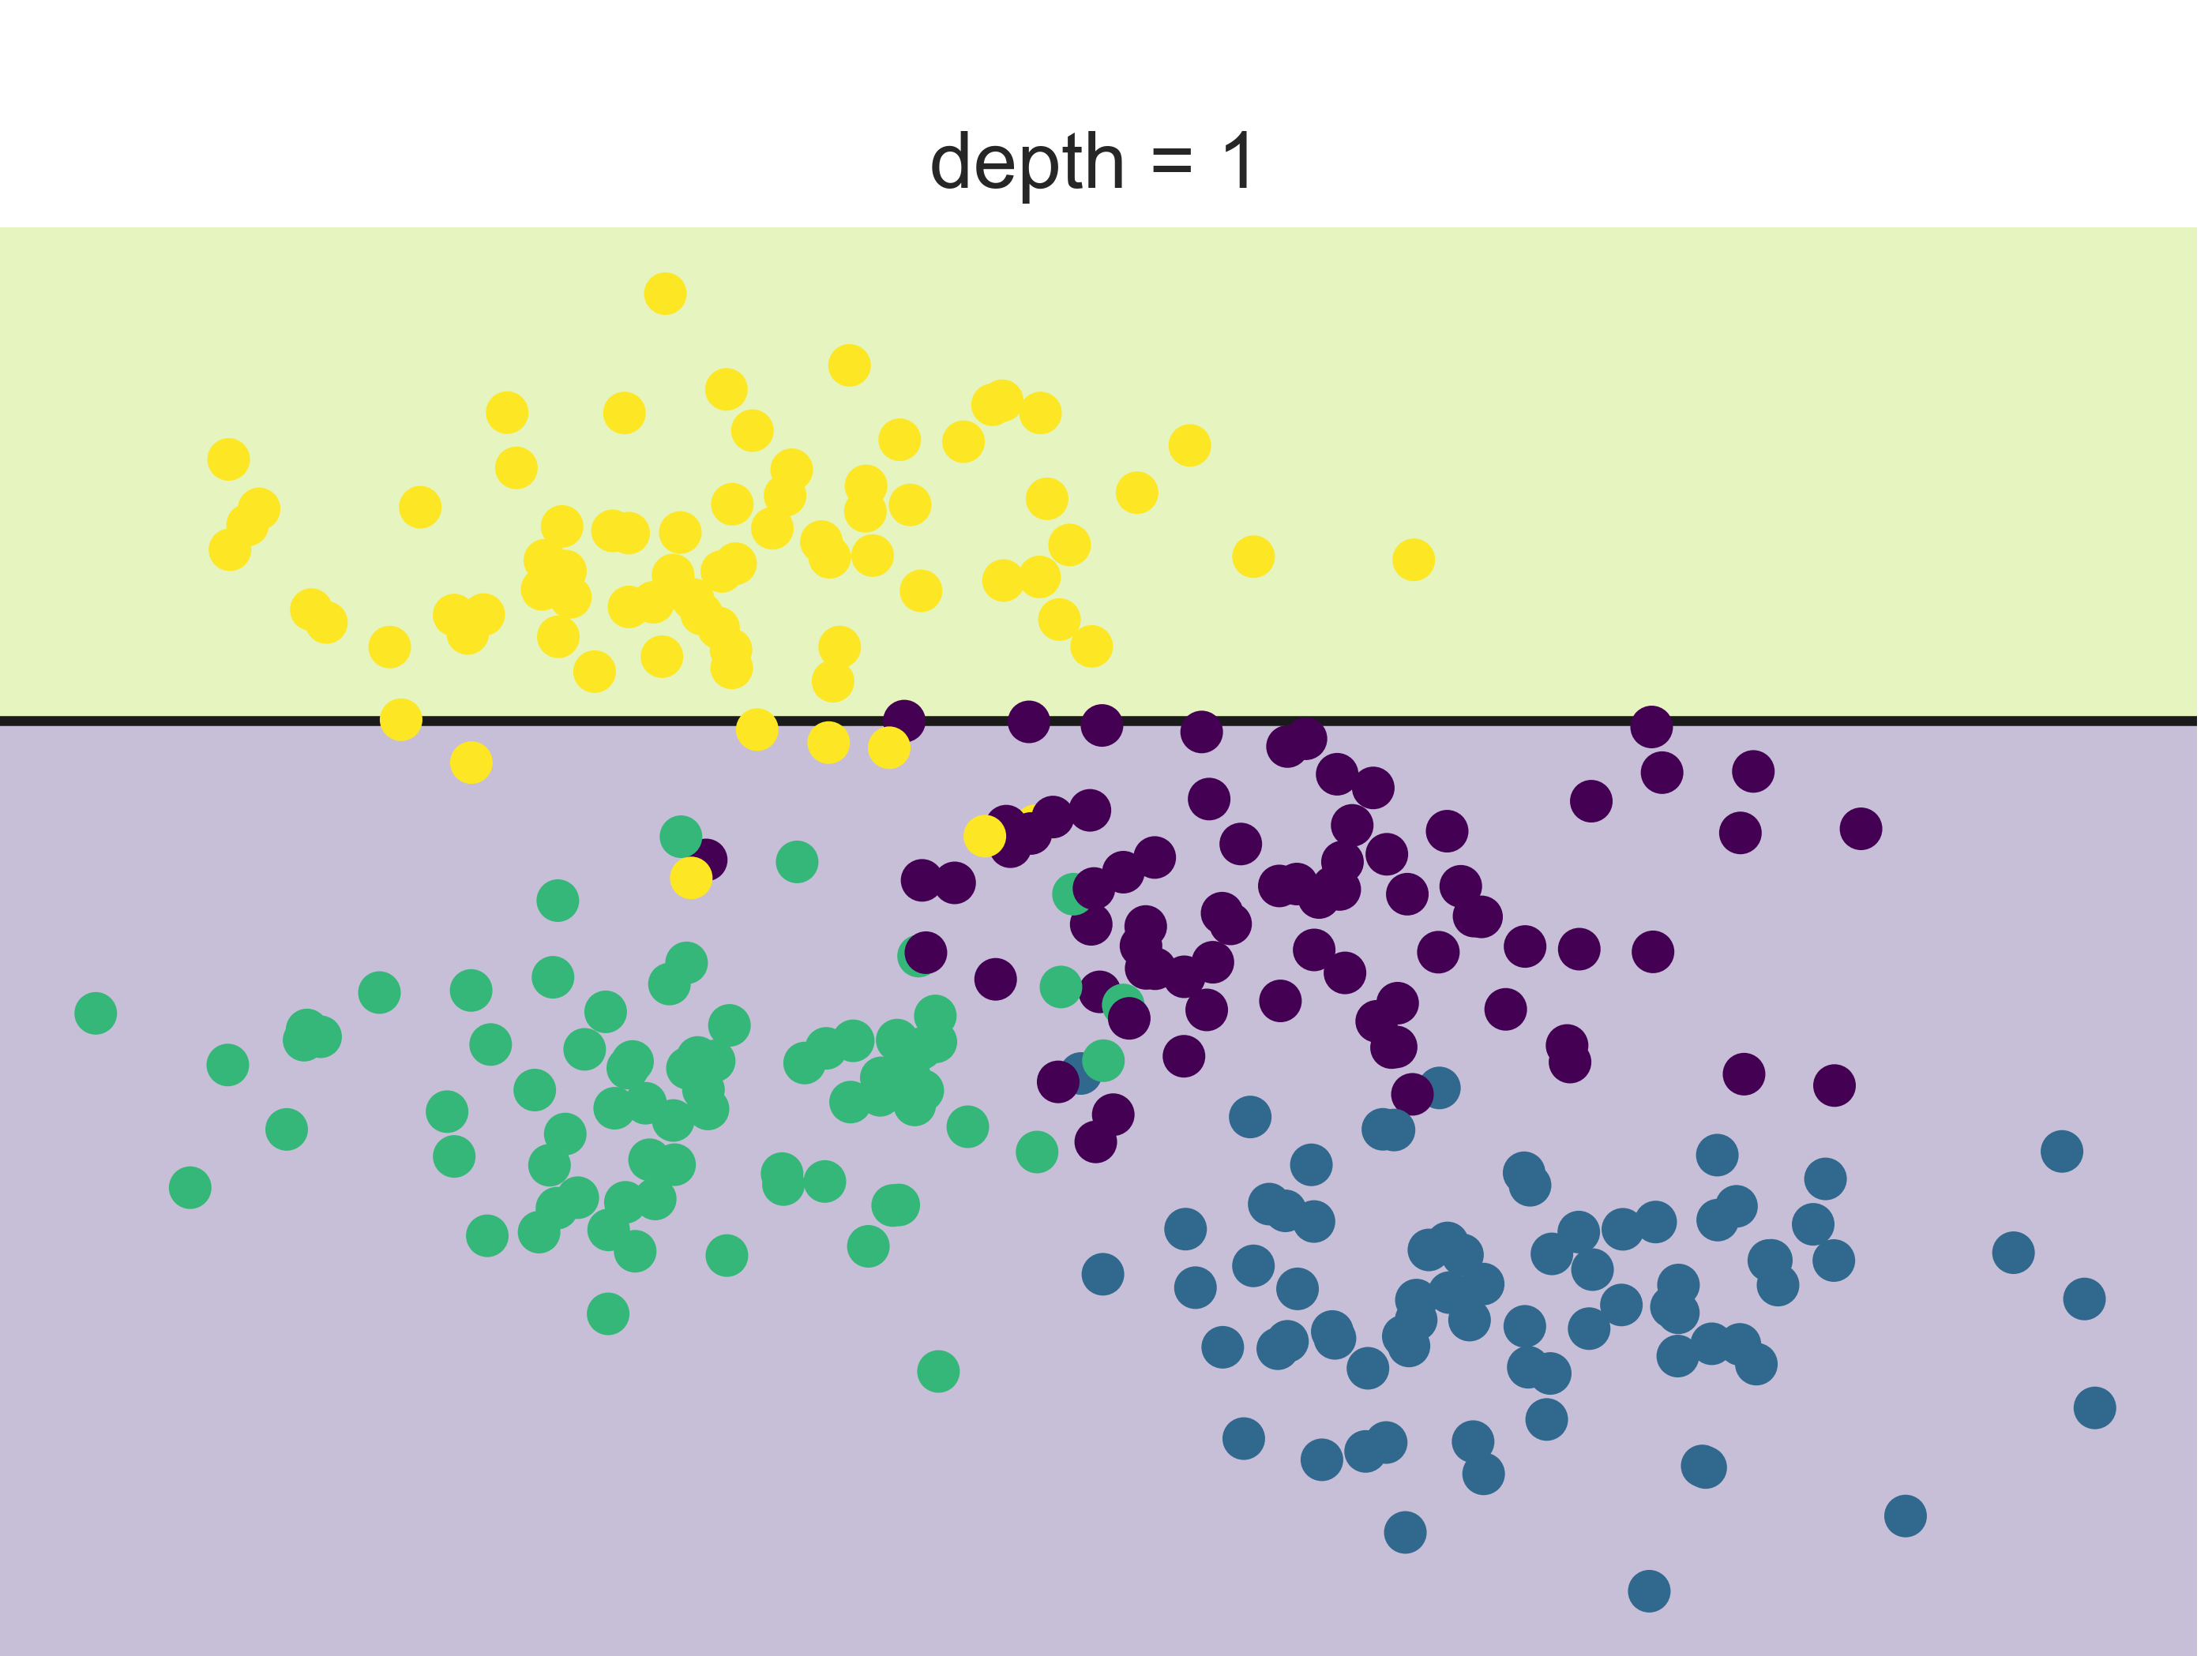
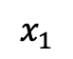
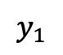
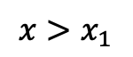
DTs example
$$y>y_{1}$$
$$x>x_{1}$$
$$y$$
yellow
$$y_{1}$$
$$x_{1}$$
$$x$$

Slide 22
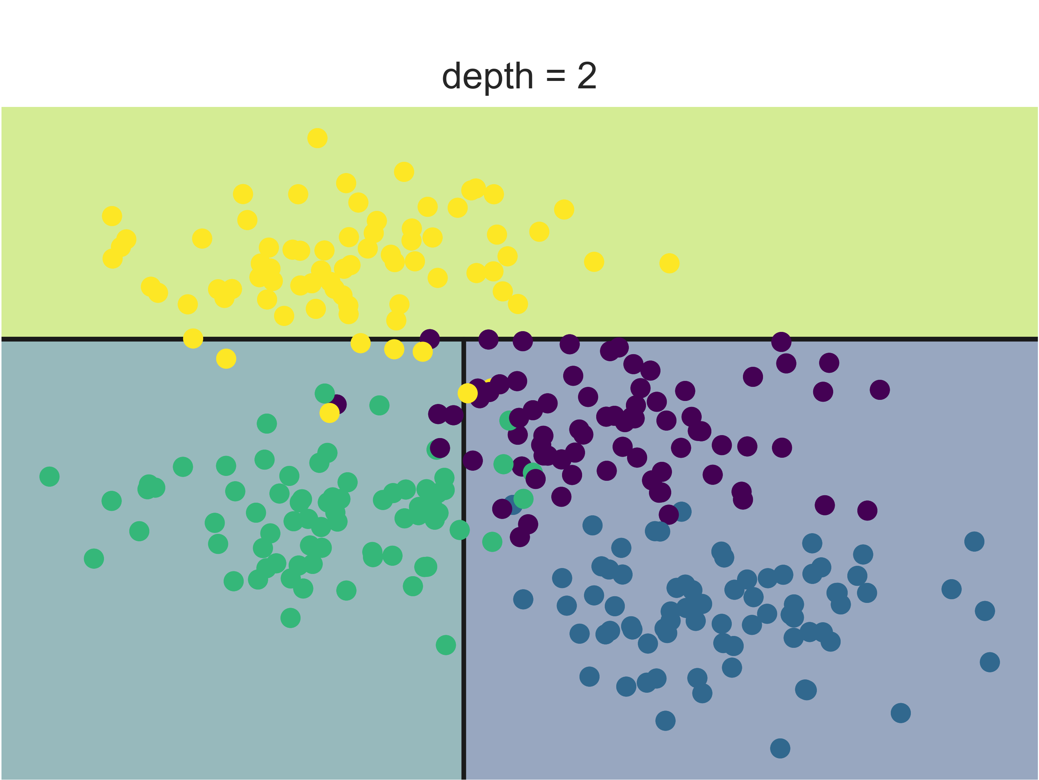
DTs example
$$y>y_{1}$$
$$x>x_{1}$$
$$y$$
yellow
$$y_{1}$$
Green
$$x_{1}$$
$$x$$

Slide 23
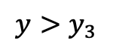
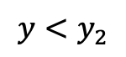
DTs example
$$y>y_{1}$$
$$x>x_{1}$$
$$y$$
yellow
$$y_{1}$$
$$y<y_{2}$$
$$y>y_{3}$$
$$x_{1}$$
$$x$$

Slide 24
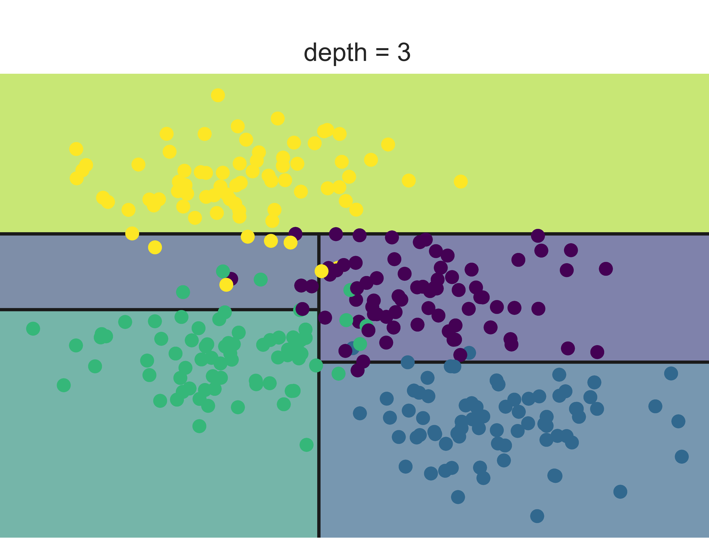
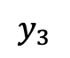
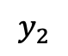
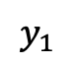
DTs example
$$y>y_{1}$$
$$x>x_{1}$$
$$y$$
yellow
$$y_{1}$$
$$y_{2}$$
$$y_{3}$$
$$y<y_{2}$$
$$y>y_{3}$$
$$x_{1}$$
$$x$$
yellow
Green
blue
purple

Slide 25
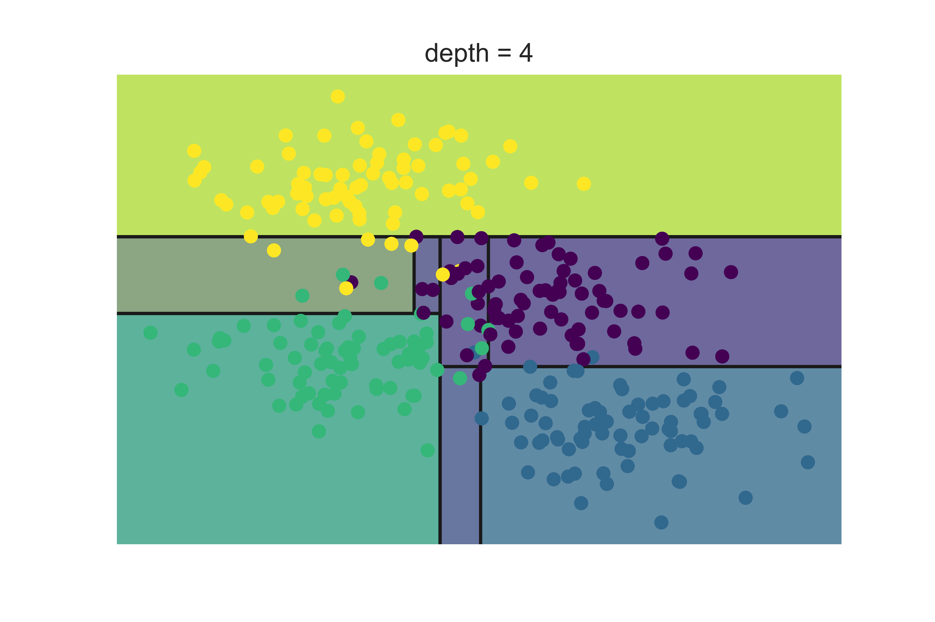
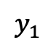
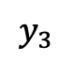
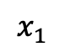
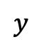
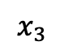
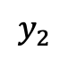
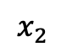
DTs example
The process is iterative..
When to stop?
$$y$$
$$y_{1}$$
$$y_{2}$$
$$y_{3}$$
$$x_{3}$$
$$x_{2}$$
$$x_{1}$$
$$x$$

Slide 26
DTs demo
Homes in San Francisco vs New York
Guess (classify) the location based on homes features
Elevation
Year built
Bathrooms
Bedrooms
Price
Prediction: San Francisco or New York

Slide 27
Building a DT
What is a good DT?
How to define the error?
How to split?
When to stop?

Slide 28
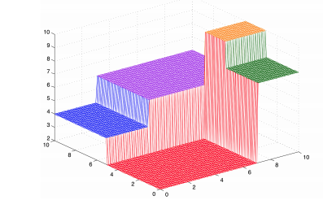
Building a DT
What is a good DT?
Homogenous space
Same elements in same region: low error

Slide 29
Building a DT
2. How to define the error?
4 Blue
4 Yellow
3 Blue
1 Yellow
1 Blue
3 Yellow

Slide 30
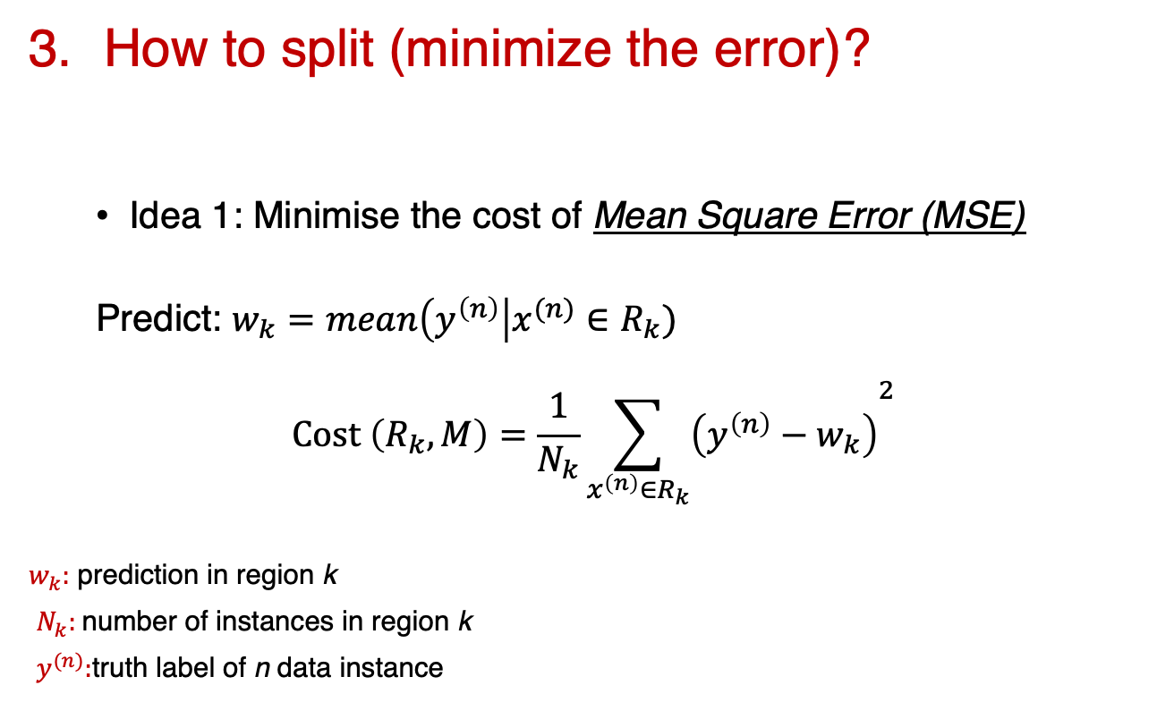
Building a DT
How to split (minimize the error)?
Idea 1: Minimise the cost of Mean Square Error (MSE)
Predict: $w_{k}=mean\left(y^{\left(n\right)}\right|x^{(n)}∈R_{k})$
$$Cost \left(R_{k}, M\right)=\frac{1}{N_{k}}{\sum_{x^{\left(n\right)}∈R_{k}}{\left(y^{\left(n\right)}−w_{k}\right)}}^{2}$$
$w_{k}:$ prediction in region k
$N_{k}:$number of instances in region k
$y^{(n)}:$truth label of n data instance

Slide 31
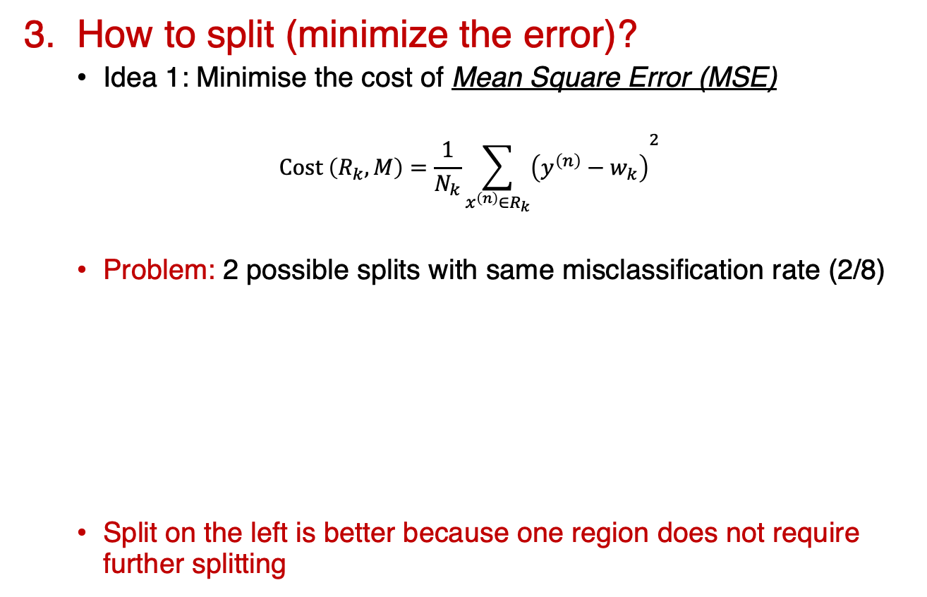
Building a DT
3. How to split (minimize the error)?
Idea 1: Minimise the cost of Mean Square Error (MSE)
$$Cost \left(R_{k}, M\right)=\frac{1}{N_{k}}{\sum_{x^{\left(n\right)}∈R_{k}}{\left(y^{\left(n\right)}−w_{k}\right)}}^{2}$$
Problem: 2 possible splits with same misclassification rate (2/8)
Split on the left is better because one region does not require further splitting
4 Blue
4 Yellow
4 Blue
4 Yellow
3 Blue
1 Yellow
1 Blue
3 Yellow
4 Blue
2 Yellow
2 Yellow

Slide 32

Building a DT
3. How to split (minimize the error)?
Idea 2: Minimise the cost of Mean Square Error (MSE)
$$Cost \left(R_{k}, M\right)=\frac{1}{N_{k}}{\sum_{x^{\left(n\right)}∈R_{k}}{\left(y^{\left(n\right)}−w_{k}\right)}}^{2}$$
Problem: 2 possible splits with same misclassification rate (2/8)
Split on the left is better because one region does not require further splitting
4 Blue
4 Yellow
4 Blue
4 Yellow
3 Blue
1 Yellow
1 Blue
3 Yellow
4 Blue
2 Yellow
2 Yellow

Slide 33
Building a DT
How to define the error?
Idea 2: Minimise the entropy
Entropy: expected amount of information in observing a random variable (y)

Slide 34
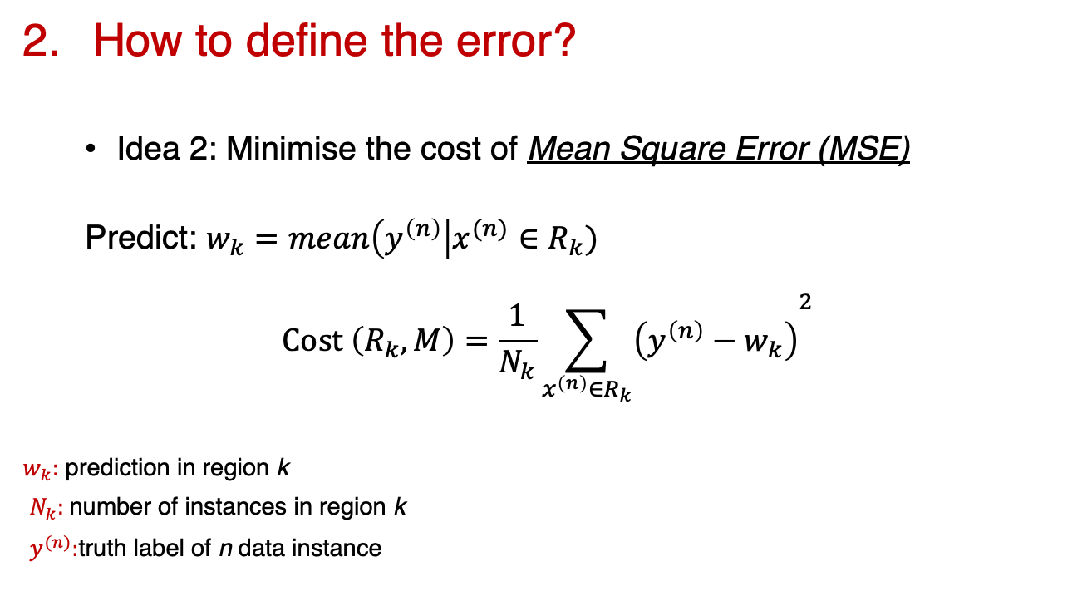
Building a DT
How to define the error?
Idea 2: Minimise the cost of Mean Square Error (MSE)
Predict: $w_{k}=mean\left(y^{\left(n\right)}\right|x^{(n)}∈R_{k})$
$$Cost \left(R_{k}, M\right)=\frac{1}{N_{k}}{\sum_{x^{\left(n\right)}∈R_{k}}{\left(y^{\left(n\right)}−w_{k}\right)}}^{2}$$
$w_{k}:$ prediction in region k
$N_{k}:$number of instances in region k
$y^{(n)}:$truth label of n data instance

Slide 35
Building a DT
What is a good DT?
How to define the error?
How to split?
When to stop?

Slide 36
Building a DT
4. When to stop?

Slide 37

15 minutes break

Slide 38
Coding session
Colab notebook

Slide 39
Artificial Neural Networks
Motivations

Slide 40
Artificial Neural Networks
ANNs demo

Slide 42
Artificial Neural Networks

Slide 43
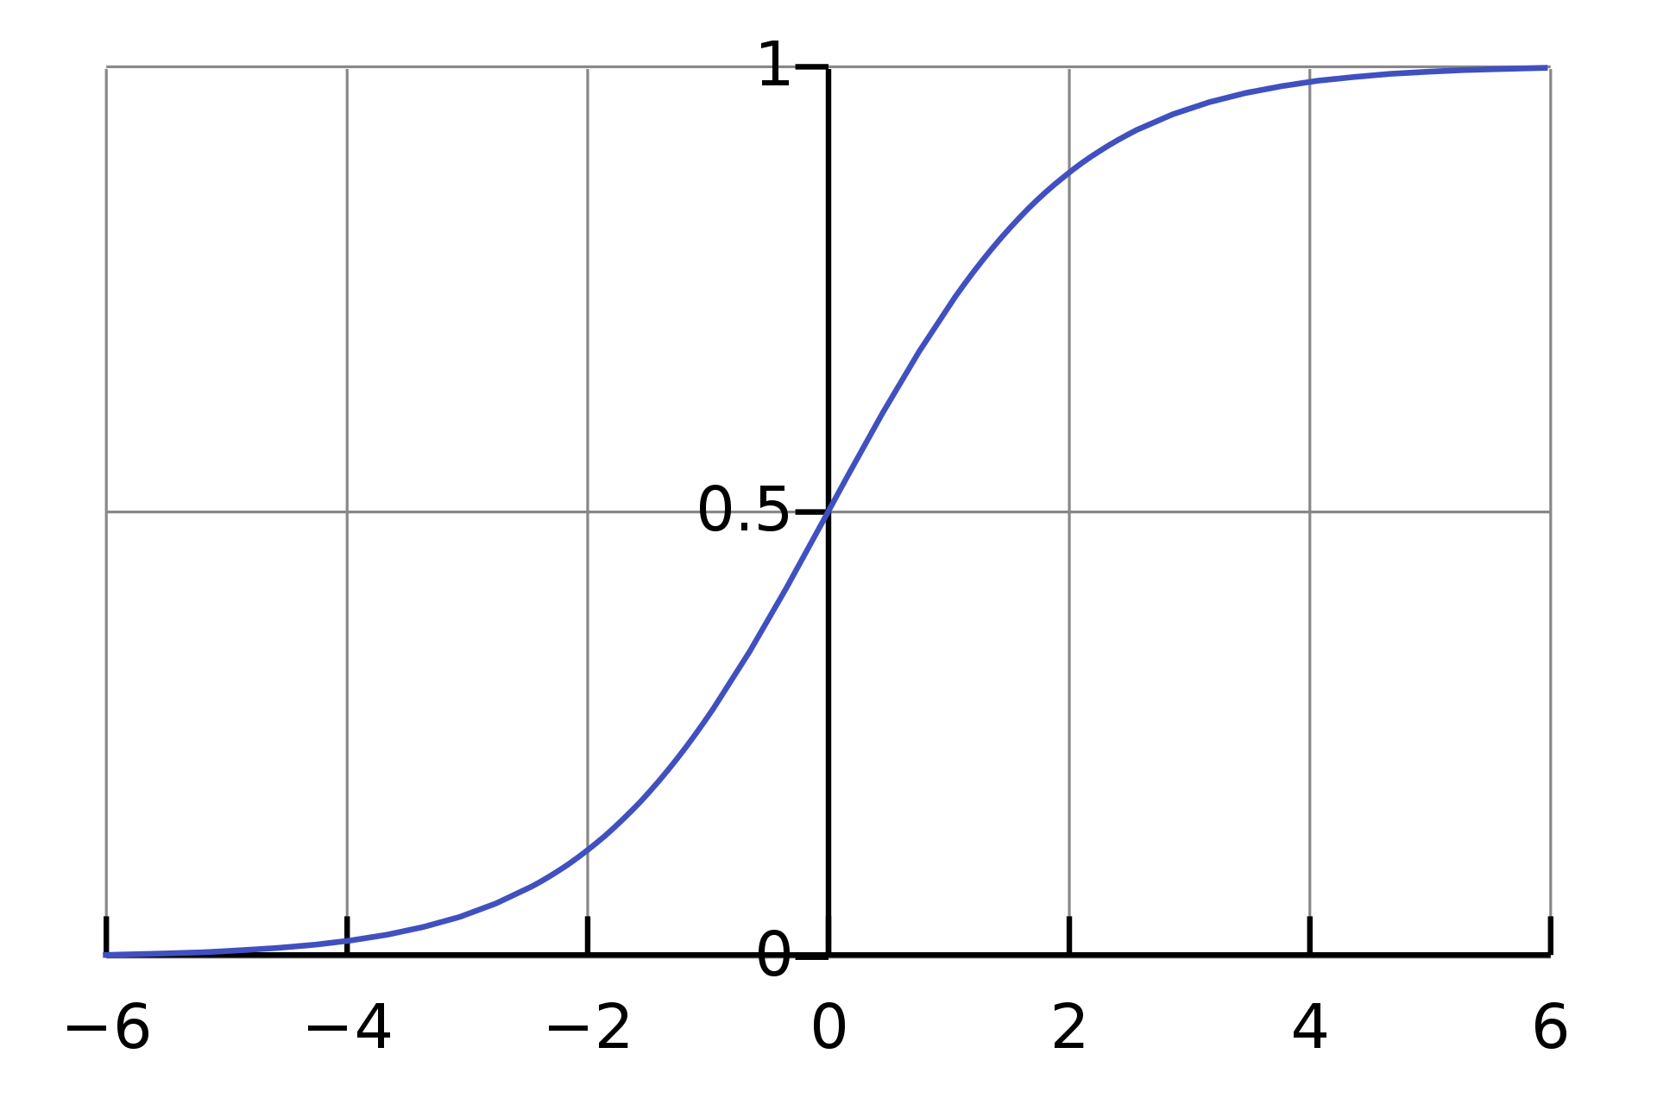
Activation function

Slide 44
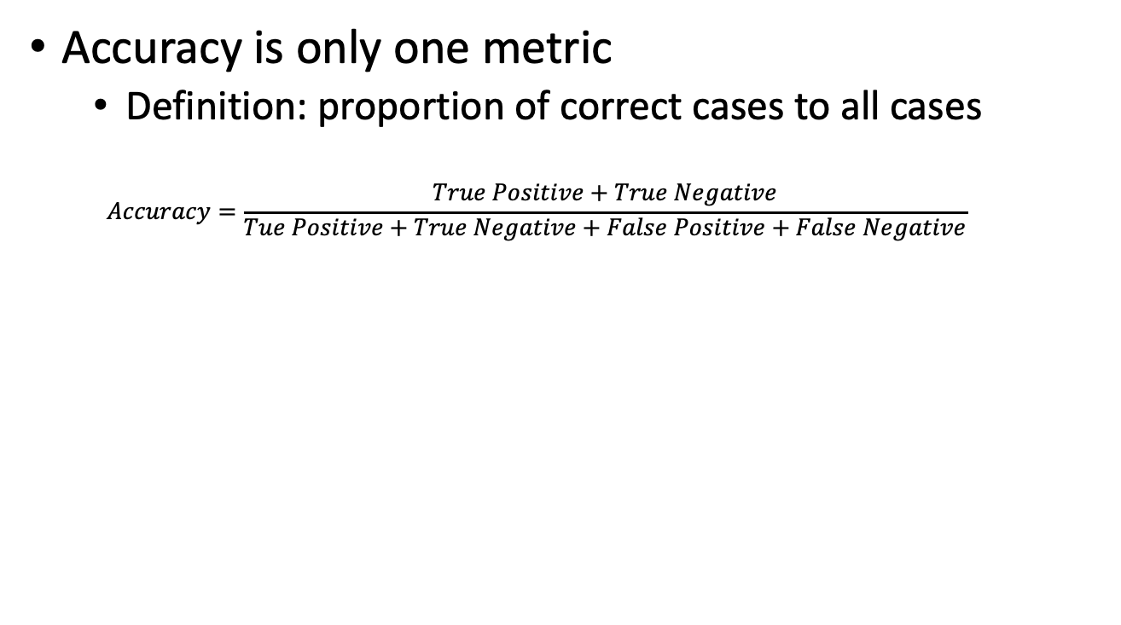
Performance metrics
Accuracy is only one metric
Definition: proportion of correct cases to all cases
$$Accuracy=\frac{True Positive+True Negative}{Tue Positive+True Negative+False Positive+False Negative}$$
Actual
 | Positive | Negative
Positive | True positive | False Positive
Negative | False Negative | True Negative
Predicted

Slide 45
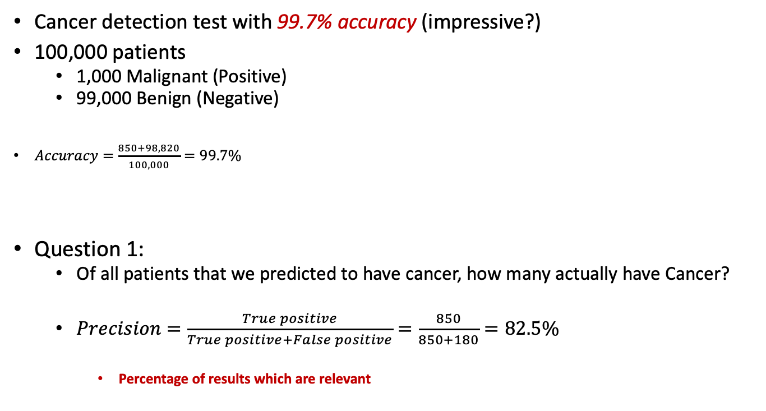
Performance metrics
Cancer detection test with 99.7% accuracy (impressive?)
100,000 patients
1,000 Malignant (Positive)
99,000 Benign (Negative)
$Accuracy=\frac{850+98,820}{100,000}=99.7\%$
Question 1:
Of all patients that we predicted to have cancer, how many actually have Cancer?
$Precision=\frac{True positive}{True positive+False positive}=\frac{850}{850+180}=82.5\%$
Percentage of results which are relevant
Actual
 | Positive | Negative
Positive | 850 | 180
Negative | 150 | 98, 820
Total | 1,000 | 99,000
Predicted

Slide 46
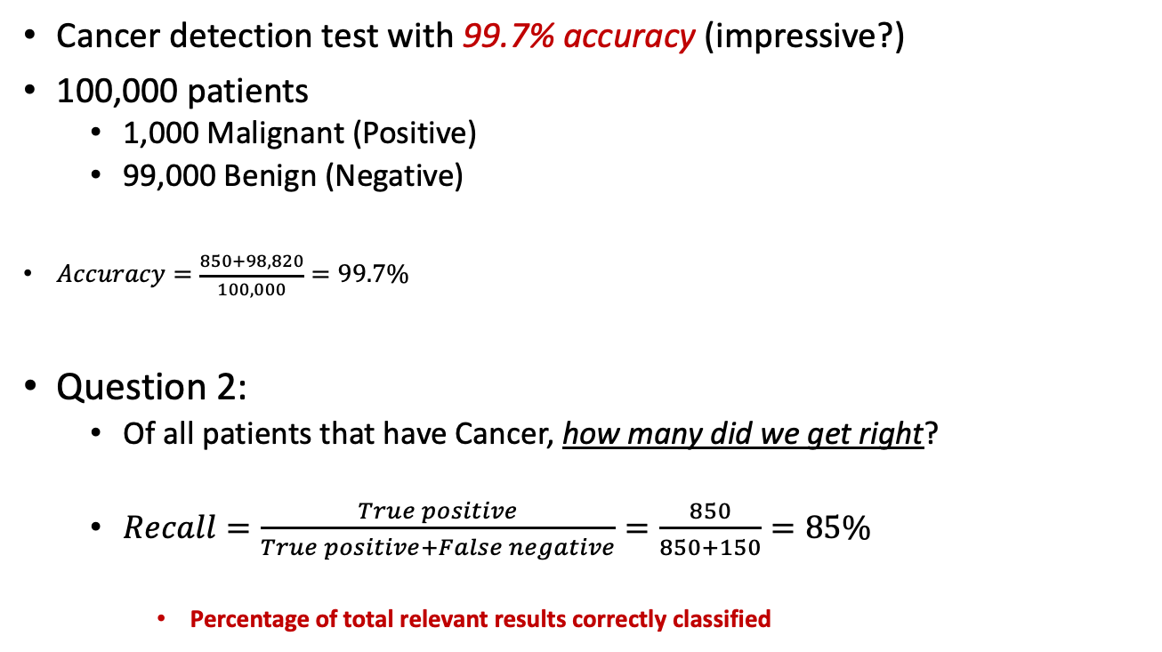
Performance metrics
Cancer detection test with 99.7% accuracy (impressive?)
100,000 patients
1,000 Malignant (Positive)
99,000 Benign (Negative)
$Accuracy=\frac{850+98,820}{100,000}=99.7\%$
Question 2:
Of all patients that have Cancer, how many did we get right?
$Recall=\frac{True positive}{True positive+False negative}=\frac{850}{850+150}=85\%$
Percentage of total relevant results correctly classified
Actual
 | Positive | Negative
Positive | 850 | 180
Negative | 150 | 98, 820
Total | 1,000 | 99,000
Predicted

Slide 47
Performance metrics
Accuracy is only one metric
Precision and recall
Confusion matrix (Coding session)
Critical for unbalanced datasets

Slide 48
Performance metrics
Accuracy is only one metric
Precision and recall
Confusion matrix
Important for unbalanced datasets

Slide 49
15 minutes break

Slide 50
Coding competition
Work on Titanic dataset

Slide 51
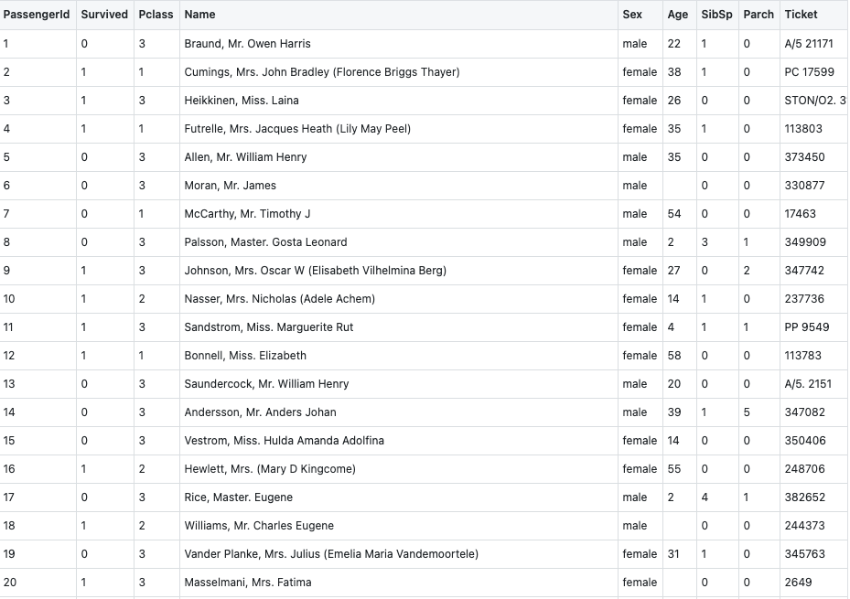
Coding competition
Work on Titanic dataset
Work in groups
Compare DTs, ANNs, and SVMs
30 minutes
Go!

Slide 52
Coding competition
Work on Titanic dataset
Work in groups
Compare DTs, ANNs, and Support Vector Machines (SVMs)?
Apply performance metrics
30 minutes
Go!

Slide 53
Deep Learning models
Convolutional Neural Networks

Slide 54
Deep Learning models
Recurrent Neural Networks

Slide 55
Next steps
Introductory books:
The Elements of Statistical Learning
Information Theory, Inference, and Learning Algorithms
Understanding Machine Learning: From Theory to Algorithms
Dive into Deep Learning
Online resources
Online courses: EdX, Coursera, ...
Datasets and competitions: Kaggle, IEEEDataPort, …
Online articles: Towards Data Science, Medium, …
Google is great ☺

Slide 56
References

Slide 57
Questions?

